Slide 1



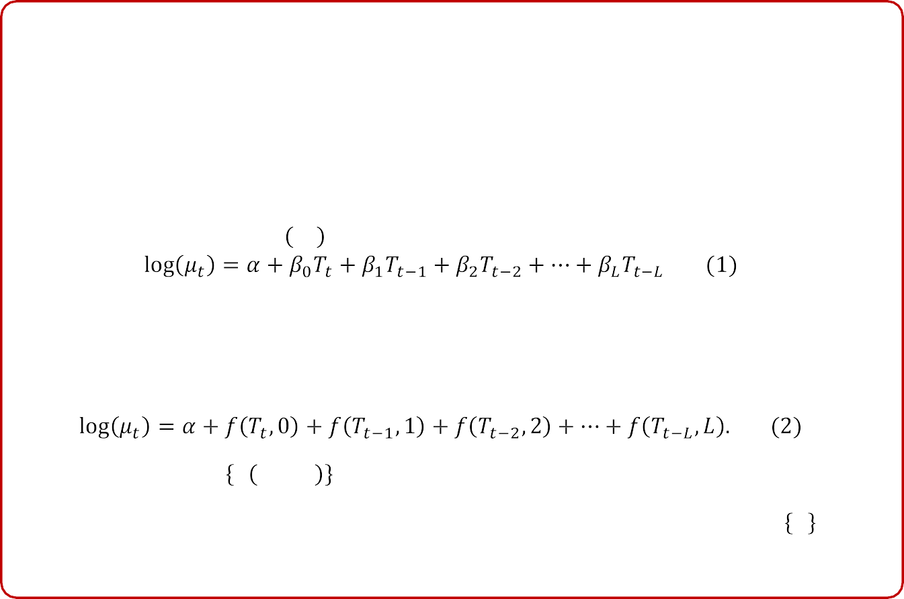
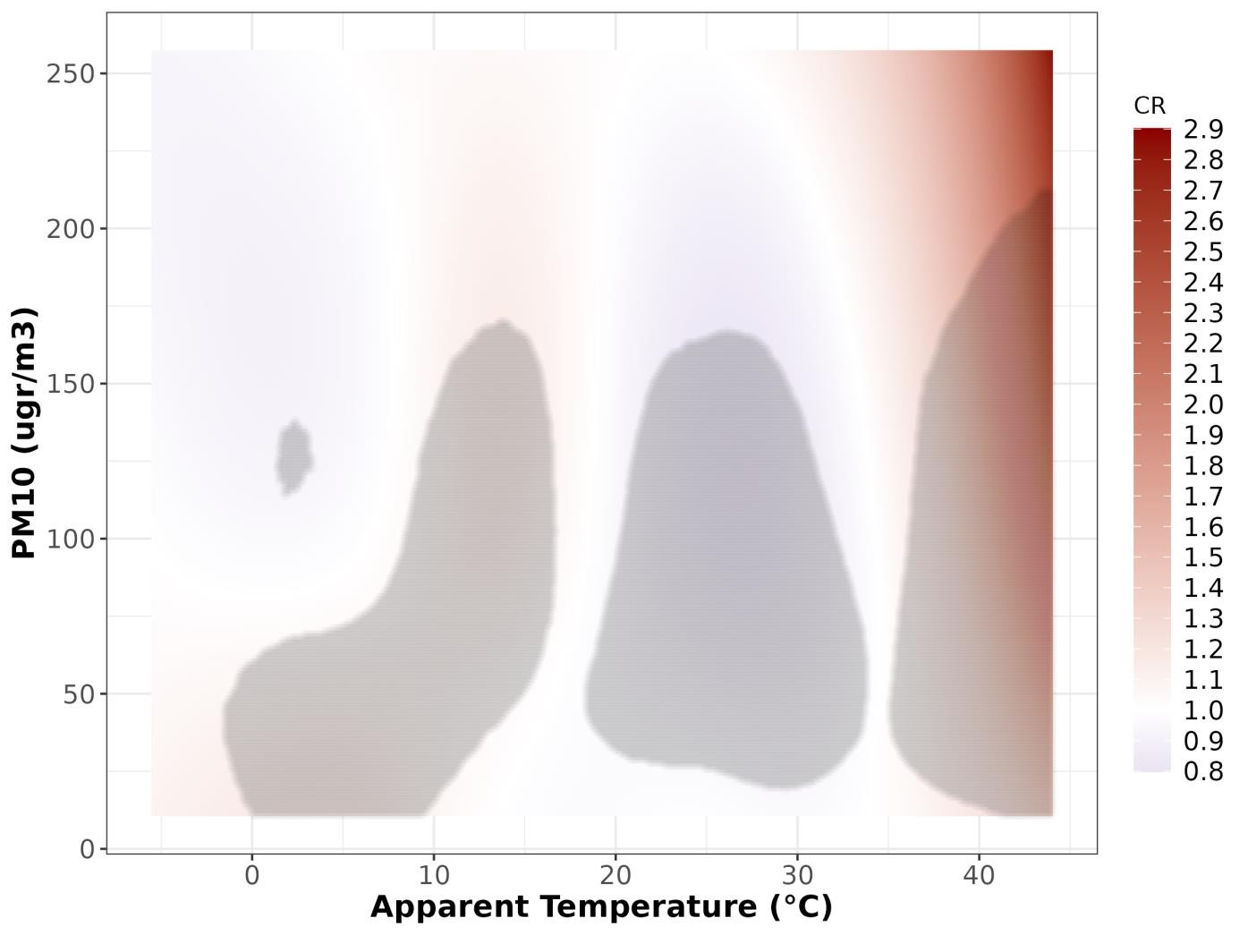
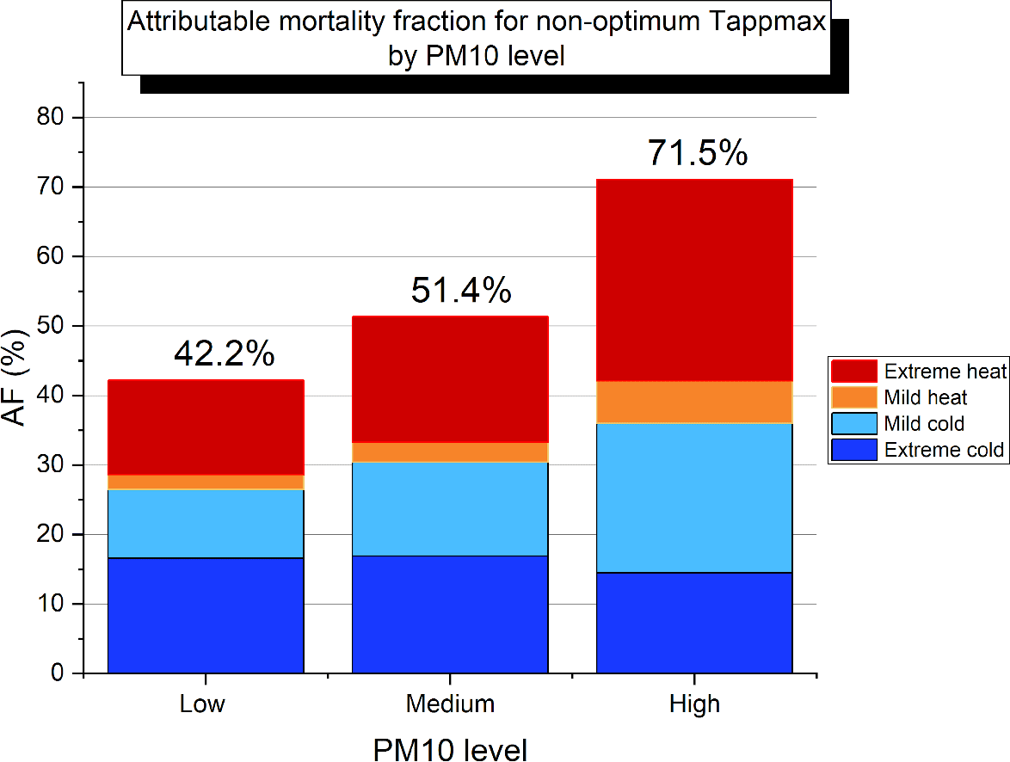
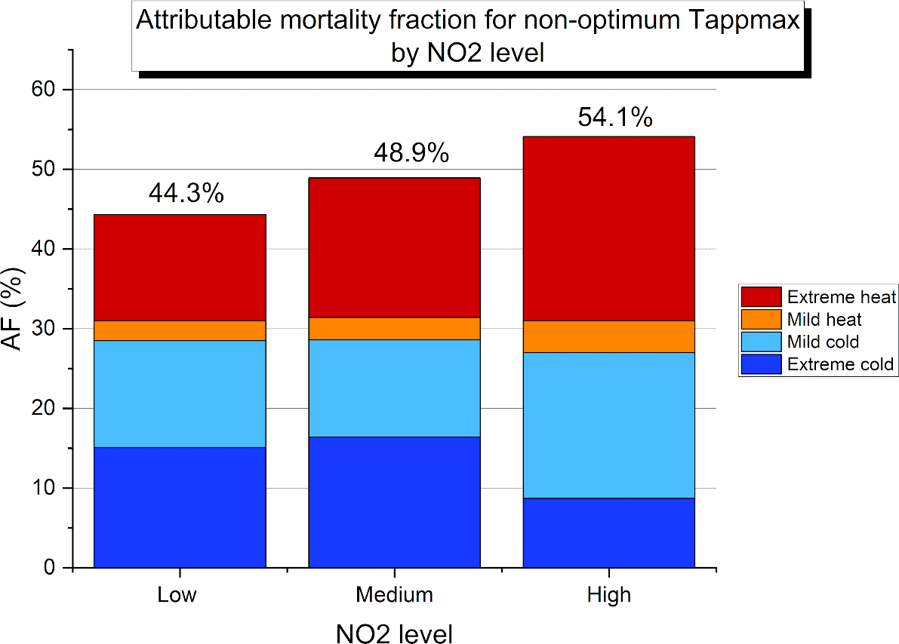
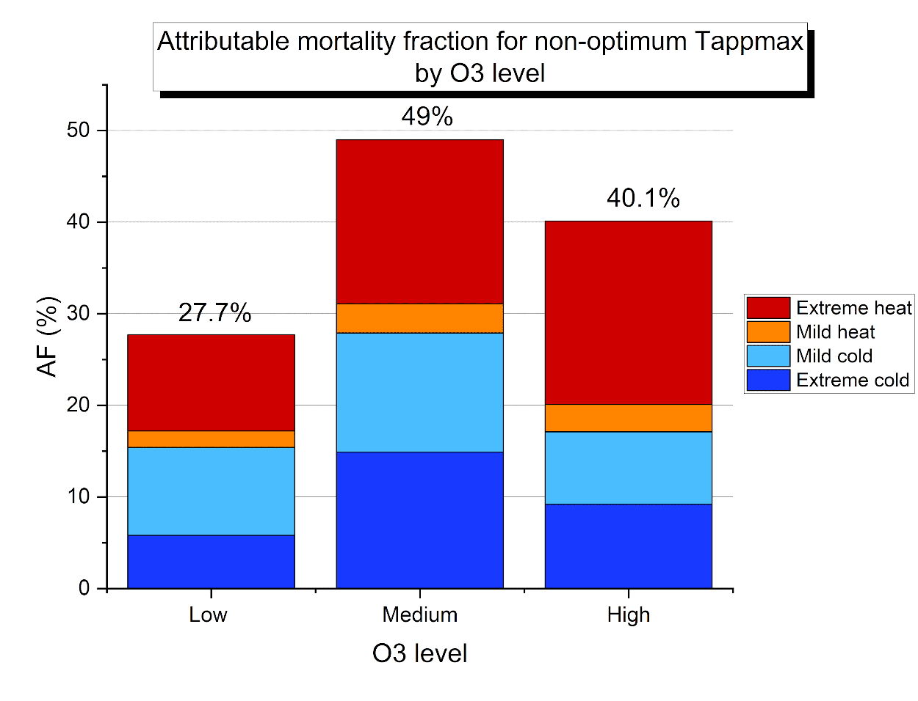
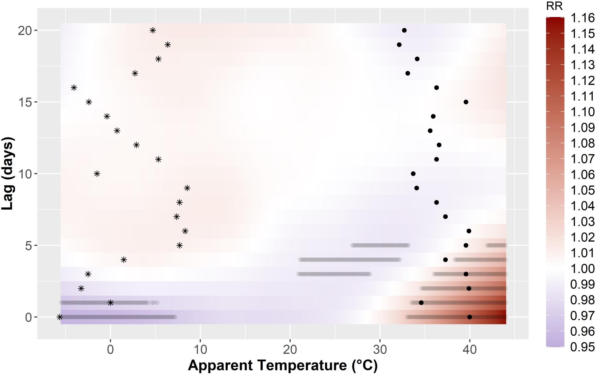
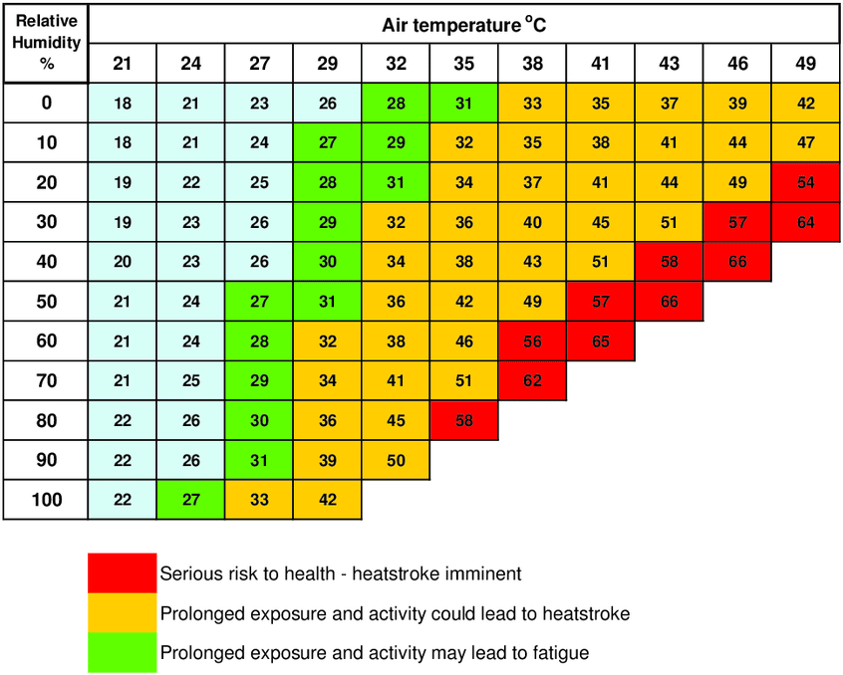
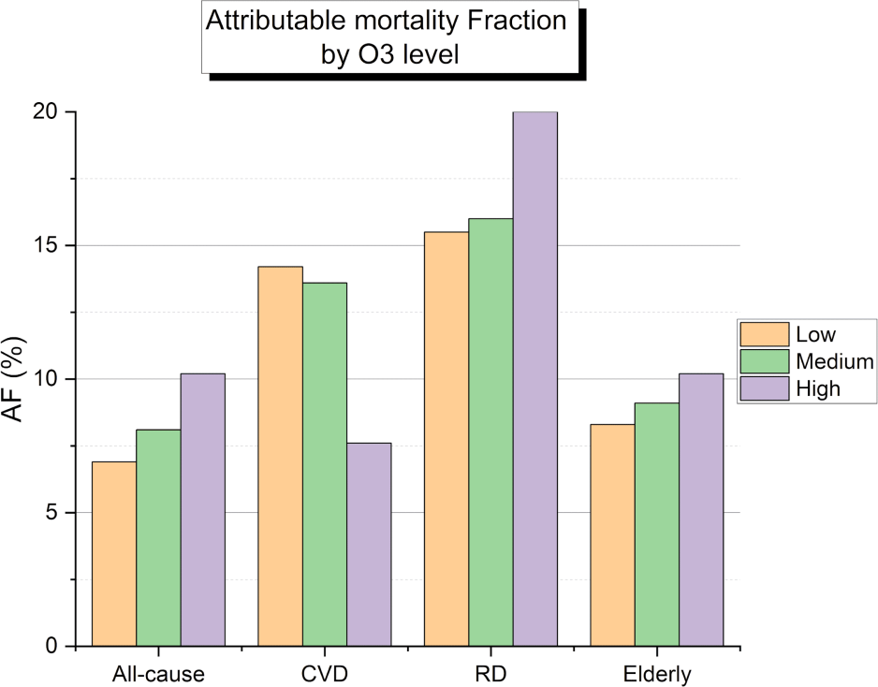
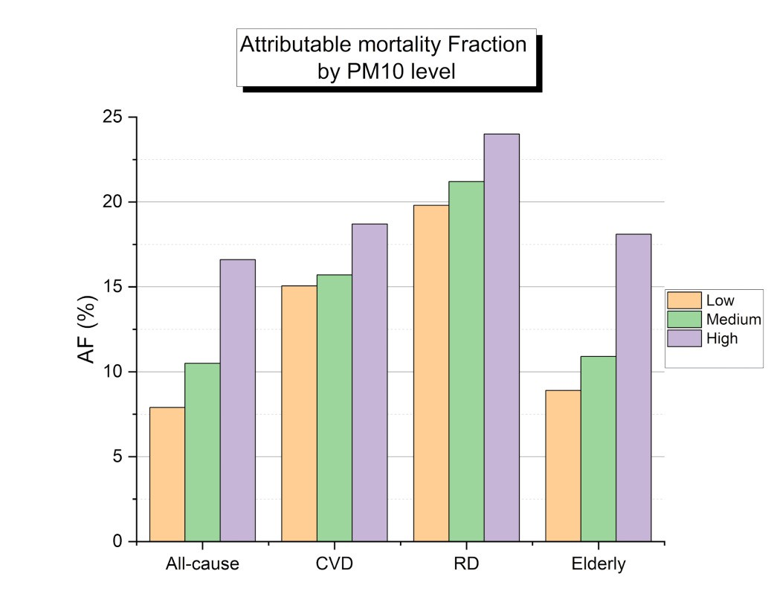
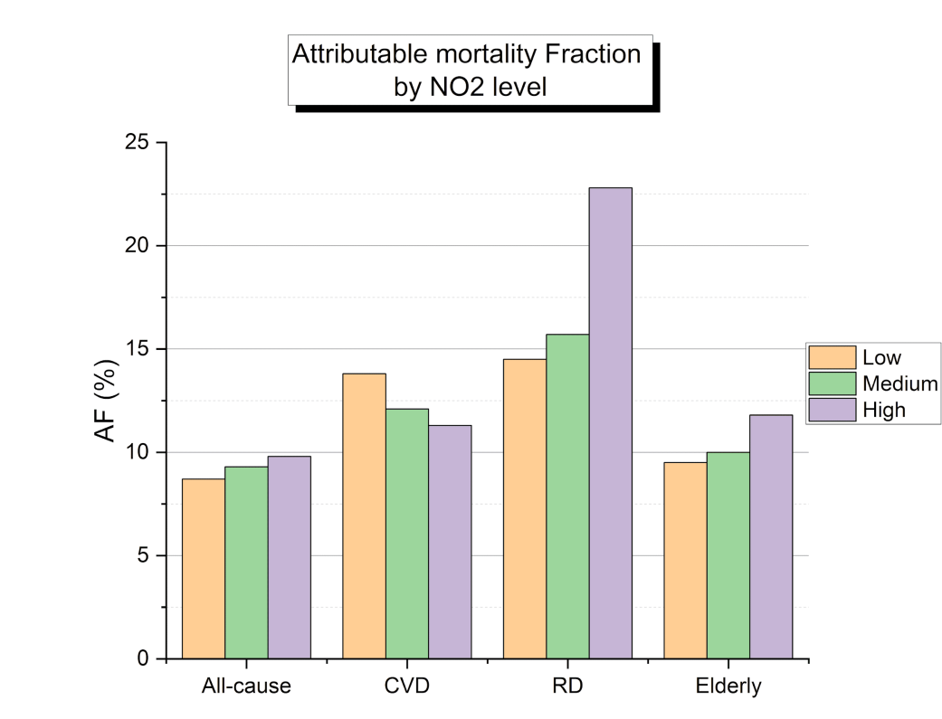
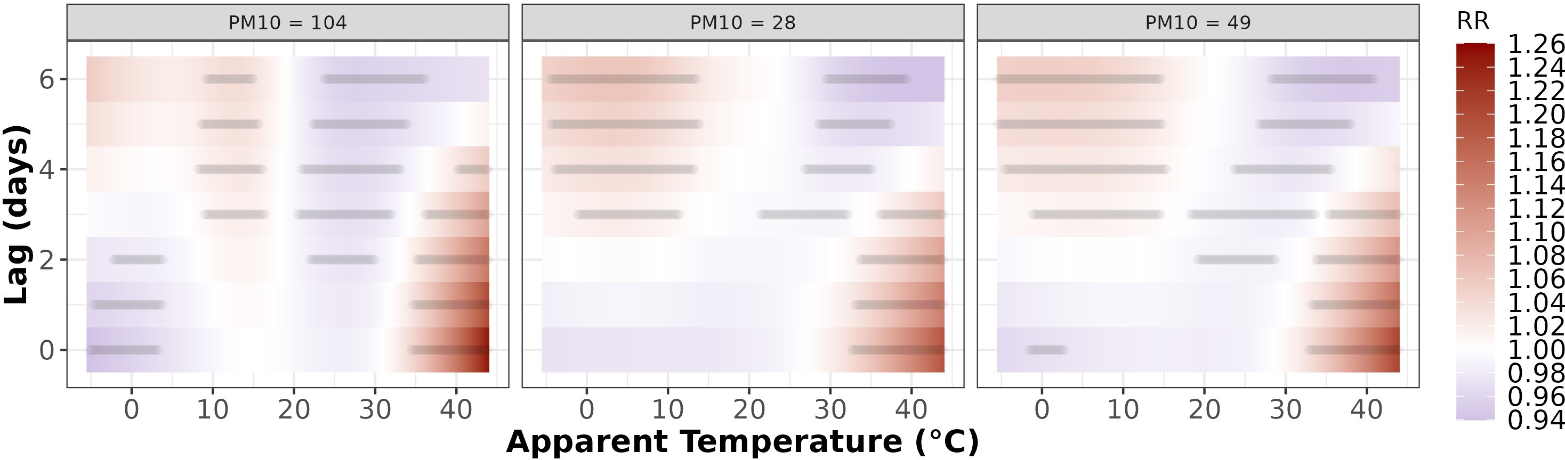

Quantifying the synergy of environmental stressors on human mortality
Theo Economou¹, Daphne Parliari², Jonilda Kushta¹ and Jos Lelieveld^{1,3}
Author Name with affiliation
Mentor Name with Affiliation
Max Planck Institute for Chemistry, Mainz, Germany
Introduction
To better understand the synergy between exposures, the lag dimension can be “integrated out” by summing the risk along lags, for different exposure combinations.
Understanding the effect of environmental stressors on human mortality can be done using statistical modelling of relevant data.
E.g., daily mortality counts 𝑀_{𝑡} (for day 𝑡) and max daily apparent temperature 𝑇_{𝑡}.
To allow for the aggregated effect of environmental stress over a period of time, regression models called Distributed Lag Models (DLMs) have been proposed:
Figure 4 shows the corresponding cumulative risk surface for apparent temperature and particulate matter (PM10) for Thessaloniki, where hot-and-humid weather combined with high PM10 results in enhanced risk.
𝑀_{𝑡} ∼ 𝑃𝑜𝑖𝑠𝑠𝑜𝑛 𝜇_{𝑡}
Figure 4. Cumulative risk for various apparent temperature and PM10 combinations.
where the coefficients 𝛽_{𝑡−𝑙} are the contribution to mean mortality count 𝜇_{𝑡}, from temperature 𝑇_{𝑡−𝑙} on day 𝑡 − 𝑙 (𝑡 being “today”). Extension to Distributed Lag Non- Linear Models or DLNMs (Gasparrrini, 2010) allows a non-linear effect from 𝑇_{𝑡−𝑙} :
To interpret the estimated risk in terms of observed mortality we compute the Attributable Fraction ̶ defined as the proportion of death counts that are attributed to the exposures.
The expression exp 𝑓 𝑇_{𝑡−𝑙} , 𝑙 is interpreted as the relative risk (RR) interpreted as
  RR = 1 means that mortality risk is equal to the mean mortality count, exp 𝛼 ;
RR > 1 or RR < 1 means higher or lower risk than average respectively.
Figure 5 shows the Attributable Fraction for 3 pollutants: PM10, Ozone (O3) and Nitrogen Dioxide (NO2).
Methodology
Implementing DLNMs as Generalized Additive Models or GAMs (Wood 2011, 2017) enables optimal estimation and straightforward interpretation. Figure 1 shows the RR for the city of Thessaloniki, Greece, based on observational data in the period 2006— 2016 (mortality counts and weather station observations).
Figure 1. Relative mortality risk (red means RR > 1, blue indicates RR < 1) as a function of apparent temperature and its temporal lags (days). Grey dots indicate regions where the relative risk is (statistically) significantly greater or lower than 1.
Black dots show the
temporal trajectory of a hot
day (24/Jul/2007) while stars indicate the trajectory of a cold day (09/Feb/2006).
Figure 5. Attributable mortality fraction stratified by apparent temperature and PM10/NO2/O3 levels.
We have also quantified the attributable mortality fraction by cause-of-death (cardiovascular disease (CVD), respiratory disease (RD) and elderly mortality (>65 years)). Figure 6 shows this for apparent temperature being between the 75th and 99th sample quantile, for increasing levels of the 3 pollutants from Figure 5.
Apparent temperature quantifies the stress from both temperature and humidity (see Figure 2), so the peak around 40°C for lags of 0-5 days indicates increased mortality risk during extreme hot-and-humid periods.
GAMs readily allow inclusion of other
stressors such as air pollution, say 𝐴_{𝑡}, by extending the function𝑓 𝑇_{𝑡−𝑙} , 𝑙 to
Figure 2. Apparent temperature as a function of air temperature and relative humidity.
Image source: Diffey (2018)
Figure 6. Cause-specific attributable mortality fraction for different levels for PM10/NO2/O3 .
^{𝑓(𝑇}𝑡−𝑙^{, 𝐴}𝑡−𝑙
, 𝑙) in Equation (2).
Conclusions
This is the first time that the lagged effects of heat-stress and air pollution synergy was studied explicitly at daily temporal resolution.
Compound effect from heat and air pollution
For 𝐴_{𝑡} being PM10 (coarse particulate matter which if >40 is considered a health risk), we now have different temperature-lag surfaces for different PM10 values (Figure 3). For Thessaloniki, the increased risk at hot-and-humid conditions is clearly exacerbated by high PM10 levels.
Our study confirms the hypothesis that mortality risk due to heat-stress is compounded by air pollution – for the city of Thessaloniki, one of the most polluted cities in Europe.
During hot-and-humid conditions: respiratory disease mortality is exacerbated for high Ozone and NO2 pollution, while elderly mortality is heightened by high PM10 levels.
Further analysis is needed to also allow for the interactions between pollutants.
References
Diffey, B. L. (2018). "Time and Place as Modifiers of Personal UV Exposure“. International Journal of Environmental Research and Public Health. https://doi.org/10.3390/ijerph15061112.
Wood, S. (2017). “Generalized Additive Models, 2nd edition”. doi = 10.1201/9781315370279.
Wood, S. (2011)., “Fast stable restricted maximum likelihood and marginal likelihood
estimation of semiparametric generalized linear models”. Journal of the Royal Statistical
Society: Series B. https://onlinelibrary.wiley.com/doi/10.1111/j.1467-9868.2010.00749.x
Gasparrini, A., Armstrong, B. and Kenward, M. G. (2010). “Distributed lag non-linear models”. Statistics in Medicine. https://onlinelibrary.wiley.com/doi/abs/10.1002/sim.3940
Figure 3. Relative mortality risk as a function of apparent temperature and its temporal lags (days), for decreasing (right to left) values of PM10.
.

Slide 2



Conclusion
Add your information, graphs and images to this section.
Recommendations
Add your information, graphs and images to this section.
Acknowledgements
Add your information, graphs and images to this section.
This Scientific Poster Template Is Provided Enter A Title And Add Logos To Your Poster
Add Author Names and Information Include University or Department Names if Needed
Results
Add your information, graphs and images to this section.
Materials
Add your information, graphs and images to this section.
Methodology
Add your information, graphs and images to this section.
Abstract
Add your information, graphs and images to this section.
Introduction
Add your information, graphs and images to this section.

